Slide 1
Single-Source Shortest Paths (Dijkstra’s Algorithm)
based on lecture note from MIT Open Courseware :
6.006 Lecture 16: Dijkstra (mit.edu) )

Slide 2

Dijkstra’s Algorithm
For each edge (u, v) $∈$ E, assume w(u, v) ≥ 0,
Maintain a set S of vertices whose final shortest path weights have been determined.
Repeatedly select u $∈$ V − S with minimum shortest path estimate
Add u to S, relax all edges out of u.

Slide 3
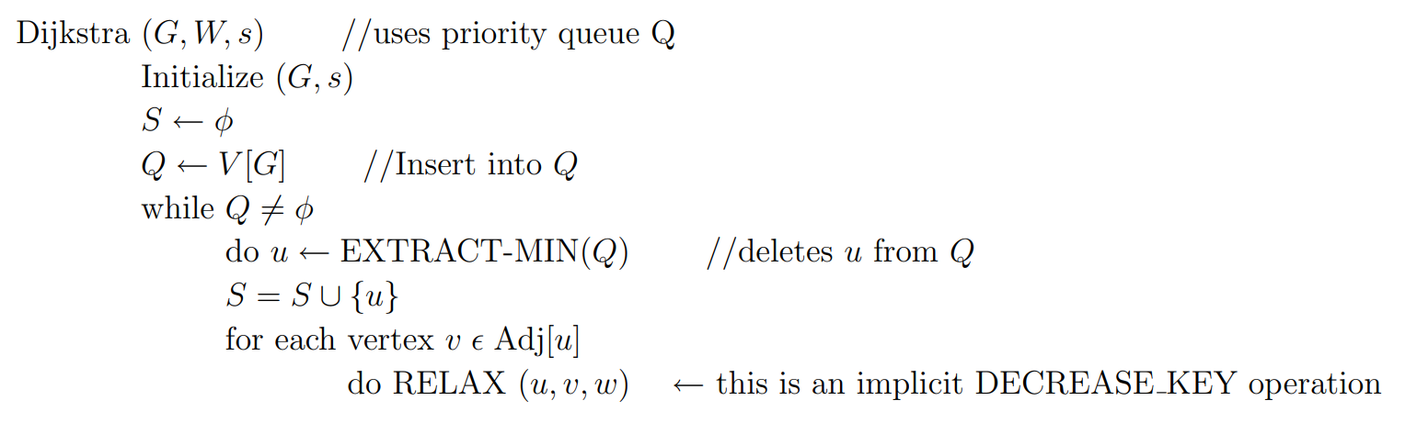
Pseudocode

Slide 4
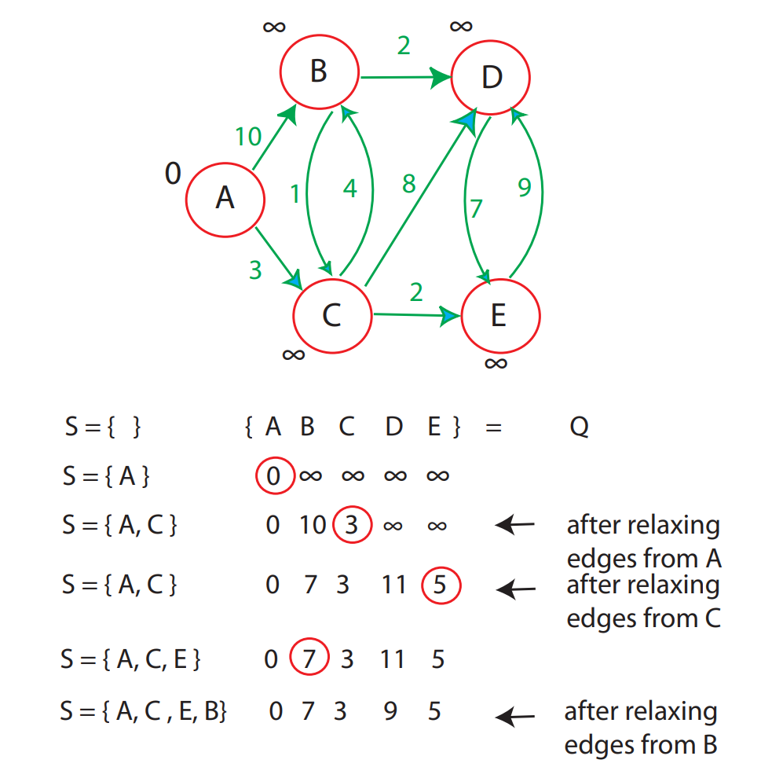
Dijkstra execution

Slide 5

Dijkstra’s SSSP with simple heap
DIJKSTRA (G, w, s)
1 for each u $∈$G.V
2 S[u] = False
3 Shortest_Etimate[u] = $∞$
4 a.vertex = s
5 a.key = 0
6 a.$π$ = NIL
7 Insert(PQ, a)
8 while PQ $≠∅$
9 t = Extract-Min(PQ)
10 u = t.vertex
11 if S[u] = False
12 S[u] = True
13 Shortest_Estimate[u] = t.key
14 for each v $∈$G.Adj[u]
15 if S[v] = False and Shortest_Estimate[u] + w(u,v) < Shortest_Estimate[v]
16 a.vertex = v
17 a.key = Shortest_Estimate[v] = Shortest_Estimate[u] + w(u,v)
18 a.$π$ = u
19 Insert(PQ, a)
Simple heap does not support changing value of node’s key.
A vertex may be inserted multiple times with different values of key.
Once a vertex is extracted, subsequent copy will be ignored.
RELAX alternative

